Slide 1

Assignment 2: Creating an Effective Visual
-By
Group 12

Slide 2
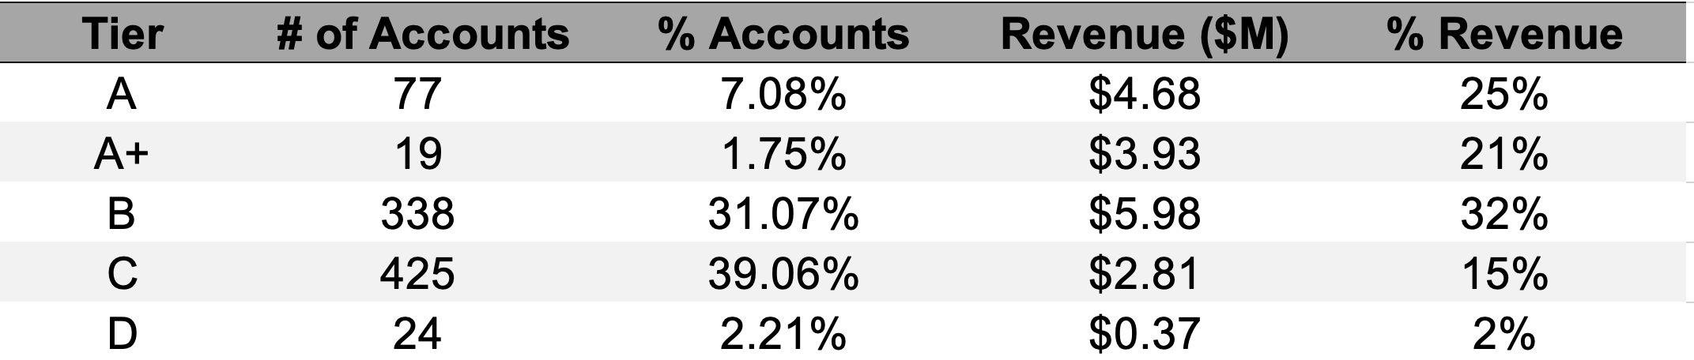
New client tier share
Observations:
The table gives us the details of number of clients acquired by each tier and their revenues generated respectively.
The tier column in the table is sorted alphabetically
Assumptions:
The percentages given are not totaling to 100%, the following can be the possible reasons.
Percentages are not calculated correctly
Information is not completely given or one of the row is missing
Questions:
Is the given information enough to understand the complete scenario?
Are there any missing rows or there any missing number of accounts in the given list of Tier?

Slide 3
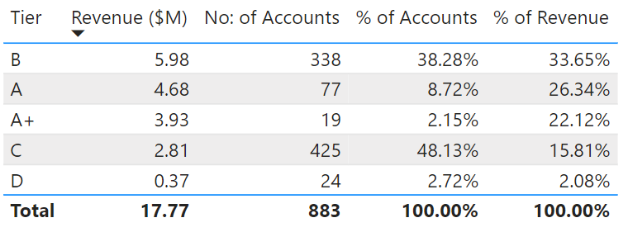
Modified table
The table is created with minimum noise and revenue column is sorted in descending order
Headers are changed to give a clear picture
Assuming that the percentages are calculated wrongly, we have recalculated “% of Revenue” and “% of Accounts” columns based on the available data.

Slide 4
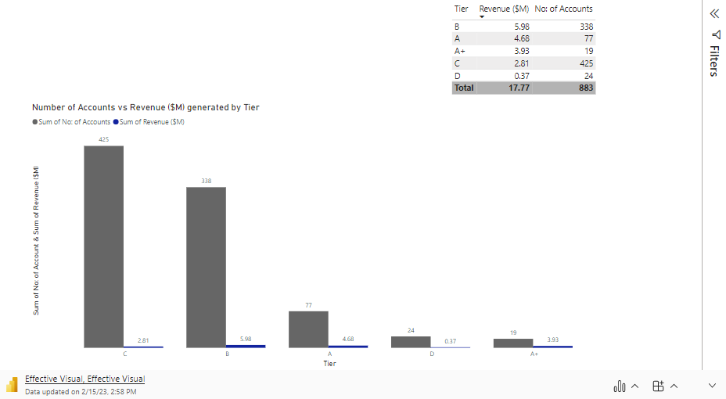
Graphical Presentation (created in Power BI)

Slide 5
Conclusion
The original table gives summary data regarding new client tier share. After doing some observations and assumptions, we have recalculated percentage of Number of accounts and percentage of Revenue.
We have decided to use a bar graph to present data in a meaningful way for comparing tier revenue and number of accounts with respect to Tier using power BI.
From the graph, we can observe that tier B generates the highest amount of revenue while tier D generates the lowest.

